Slide 1


Next Level Assignment-2 A Brief Demonstration
Express server for fake product and order data for API testing built with Express.js, MongoDB and Typescript.

Slide 2

JSON DATA USED IN THE PROJECT
Product Data
Contains Name, Brand, Category, Price, Quantity, InStock and other values
Order Data
Contains email, ProductId, Quantity and Total Price.

Slide 3
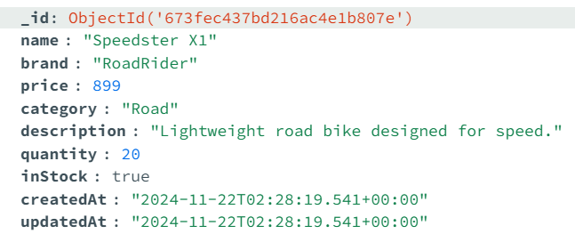
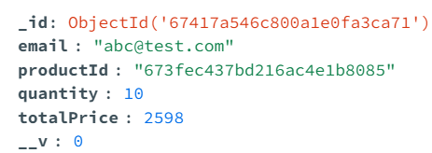
Product and Order Data Schema
Product
Order

Slide 4

API Endpoints for Product Api calls
Get a single Bike by ID
https://assignmentvercelone.vercel.app/api/products/673fec437bd216ac4e1b8085
Get Bikes by Category, Brand or Name
https://assignmentvercel-one.vercel.app/api/products?searchTerm=CityCycle
https://assignmentvercel-one.vercel.app/api/products?searchTerm=Mountain
https://assignmentvercel-one.vercel.app/api/products?searchTerm=Road
Create a Bike
https://assignmentvercel-one.vercel.app/api/products
Update a Bike
https://assignmentvercel-one.vercel.app/api/products/673fec437bd216ac4e1b808a
Delete a Bike
https://assignmentvercelone.vercel.app/api/products/674011efe649fa028c41ff44

Slide 5
API Endpoints for Order Api calls
Create an Order
https://assignmentvercel-one.vercel.app/api/orders
Calculate Total Revenue
https://assignmentvercel-one.vercel.app/api/orders/revenue

